Slide 1


Preventing Human-Bear Conflict with Behavioural Insights
2025 PARKS+ Collective eSummit

Slide 2
Collaborators and Support
The University of British Columbia
Sumeet Gulati
David J. Hardisty
Cole Burton
Rumi Naito
Sima Khanal
Agamveer Kalra
Raunaq Nambiar
BC Parks
Don Carruthers Den Hoed
Sharilynn Wardrop
Melanie Percy
Erin Kendall
Park Managers
Troy Davis, Manning Park
Ryan Turral, Cultus Lake
Michael Zavaglia, Cultus Lake

Slide 3
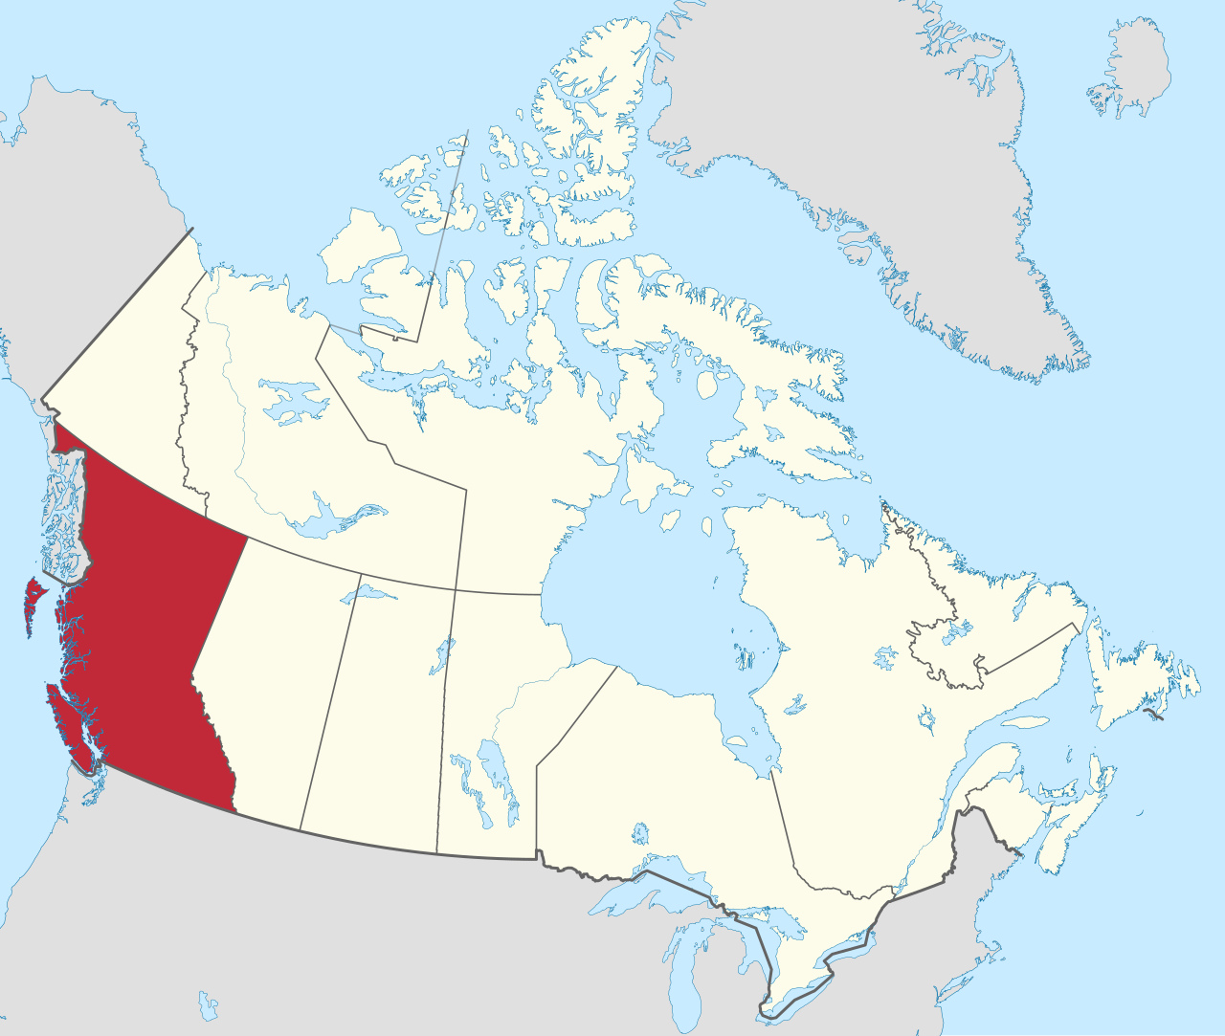
Lands
UBC Vancouver Campus
Musqueam
Squamish
Tsleil-Waututh
Manning Park
Stó:lō
Similkameen
Cultus Lake
Ts'elxwéyeqw
Soowahlie

Slide 4
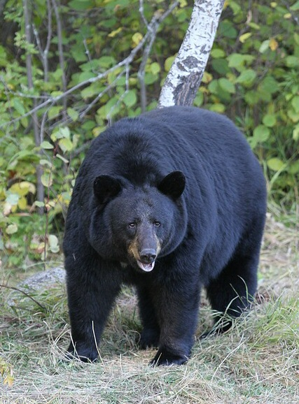
Human Bear Conflict: The Problem
Humans are increasingly encroaching on bear habitat (exacerbated by climate change)
Food and food odours attract bears, leading to conflict and the death of the bear
Over 500 bears are killed each year in BC, and 2024 was the highest year on record
It is illegal to leave out bear attractants at campgrounds and homes near bear habitats, but people still do it (i.e., policy solution is in place, but not enough compliance)
Notes:
Image from https://en.wikipedia.org/wiki/American_black_bear#/media/File:01_Schwarzb%C3%A4r.jpg
CC BY-SA 3.0

Slide 5
Behavioural Insights Approach
Applying social science research (such as psychology and economics)
to encourage better choices for individuals and society
often used in public policy
Example: using defaults to increase household uptake of green energy

Slide 6
Research Question
What is the most effective way to improve human behavior and decrease unattended bear attractants?
Additional information?
Financial incentive? ($10 gift card to Tim Hortons)
Social nudge? (responsible camper sticker)

Slide 7
Research Design
Condition 1 (C1): Control
No intervention provided.

Slide 8


Research Design
Condition 2 (C2): Information only
Provide campsite visitors with a card containing information on bear-safe behaviors and a list of bear attractants that should be avoided.

Slide 9

Research Design
Condition 3 (C3): Information + Financial incentive
Provide campsite visitors with a card and offer a cash reward for maintaining a “bare” campsite

Slide 10

Research Design
Condition 4 (C4): Information + Sticker
Provide campsite visitors with a card and offer a “responsible camper” sticker reward for maintaining a “bare” campsite

Slide 11
Research Design
Interventions given to campers by our research assistants, shadowing park staff when they check in visitors (N=257 campsites)
Data on bear attractant behavior collected by research assistants via observation each morning
Key outcome: Attractant violations (rated 0, 1 ,or 2)
Violation Score | Description
0 - No violations | No attractants recorded.
1 - Moderate Violations | At least one but no more than 3 attractant category violations observed, AND no severe attractant category (Food and Food Scraps, Garbage) violation observed.
2 - Severe Violations | 3 or more attractant category violations observed, OR at least one severe attractant category violation observed.

Slide 12
Research Design
Condition 1 (C1): Control
Condition 2 (C2): Information only
Condition 3 (C3): Information (C2) + Financial incentive
Condition 4 (C4): Information (C2) + Sticker
Your prediction? Which condition is most effective for reducing violations?

Slide 13
Results

Slide 14
Results
Control Group: The Control group had the highest mean violation score (1.30)
Information Group: 34% reduction compared to the Control group.
Information + Gift Card Group: 44% reduction compared to the Control group.
Information + Sticker Group: 50% reduction compared to the Control group, achieving the lowest average score.

Slide 15
Anecdotal Result
We did not collect any data on camper demographics, but our research assistants noticed something:
The sticker condition was especially effective among families with children

Slide 16
Next Steps
Testing again in Cultus Lake this summer
Collecting systematic data on camper demographics

Slide 17
Key Takeaways
Improved information, detailing exactly what to do and how to do it, improves camper behaviour
Financial and/or sticker incentives may help a bit more

Slide 18
Thank you!

Slide 19
Bonus Slide: Additional Results
Tukey's HSD Test Results
Comparison | Mean Difference | Lower CI | Upper CI | Adjusted p-value
Information vs. Control | -0.439 | -0.750 | -0.127 | 0.0019
Information + Gift Card vs. Control | -0.563 | -0.872 | -0.253 | <0.0001
Information + Sticker vs. Control | -0.645 | -0.957 | -0.333 | <0.0001
Information + Gift Card vs. Information | -0.124 | -0.437 | 0.189 | 0.7341
Information + Sticker vs. Information | -0.207 | -0.522 | 0.109 | 0.3288
Information + Sticker vs. Information Gift Card | -0.082 | -0.395 | 0.231 | 0.9043

Slide 20
Bonus Slide: Additional Results

